Slide 1
CPE202/CSC201 Microprocessor Programming Tutorial #1
Dr. Sundaram Suresh
N4-02b-67, School of Computer Engineering
Nanyang Technological University
Email: ssundaram@ntu.edu.sg

Slide 2
Outline
Number Representation
Binary
Hexadecimal
Signed bit Representation
Two’s Complement Representation
Binary Arithmetic
Addition
Subtraction

Slide 3
Number Representation
Patterns of bits can represent many different things. Anything that can be represented with symbols of any kind can be represented with bit patterns.
What is representation?
XII
///// ///// //
12
Twelve
1100₂
C₁₆
They are different representation of same number.

Slide 4
Binary Representation
Computer Science is concerned with using patterns of bits to represent things.
It is important to be clear about the difference between the thing, and a representation of the thing.
For example, an integer may be represented using a bit pattern in computer memory. (There are many different ways to do this.)
The integer is conceptual.
The bit pattern is only a representation of the concept.

Slide 5
Representation using Binary
Base ‘2’ representation
1011 = 1 × 2³ + 0 × 2² + 1 × 2¹ + 1 × 2⁰
= 1 × 8 + 0 × 4 + 1 × 2 + 1 × 1
= 8 + 0 + 2 + 1
= 11

Slide 6
Favorite Binary Numbers
Binary | Decimal | Notes
0000 0000 | 0
0000 0001 | 1 | 2⁰ = 1 = 2¹ - 1
0000 0011 | 3 | 2¹ + 2⁰ = 3 = 2² - 1
0000 0100 | 4 | 2²
0000 0111 | 7 | 2² + 2¹ + 2⁰ = 2³ - 1
0000 1000 | 8 | 2³
0000 1111 | 15 | 2⁴ - 1
0001 0000 | 16 | 2⁴
0001 1111 | 31 | 2⁵ - 1
0010 0000 | 32 | 2⁵
0111 1111 | ? | ?
1000 0000 | 128 | 2⁷
0111 1111 is one less than 1000 0000, which is 128. So 0111 1111 represents of 127₁₀

Slide 7
Favorite Binary Numbers
Binary | Decimal | Notes
0000 0001 | 1
0000 0010 | 2 | 1 × 2
0000 0100 | 4 | 2 × 2
0000 1000 | 8 | 4 × 2
0000 0011 | 3
0000 0110 | 6 | 3 × 2
0000 1100 | 12 | 6 × 2
0001 1000 | 24 | 12 × 2
0000 0111 | 7
0000 1110 | 14 | 7 × 2
0001 1100 | 28 | 14 × 2
0011 0000 | 56 | 28 × 2

Slide 8
Hexadecimal Representation
Base 16 representation
There are 16 digits representing 0 up to 15
0000 – 0
0001 – 1
0010 – 2
0011 – 3
0100 – 4
0101 – 5
0110 – 6
0111 – 7
1000 – 8
1001 – 9
1010 – A
1011 – B
1100 – C
1101 – D
1110 – E
1111 - F

Slide 9
Converting Hexadecimal to Decimal
Example: H’ 31A
= 3 × 16² + 1 × 16¹ + 10 × 16⁰
= 3 × 256 + 1 × 16 + 10 × 1
= 794₁₀

Slide 10
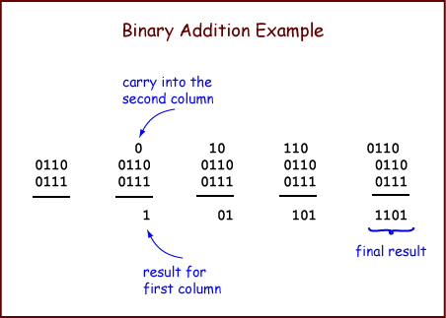
Binary Addition
To add two N-bit (representations of) integers: Proceed from right-to-left, column-by-column, until you reach the left-most column.
For each column, perform 1-bit addition.
Write the carry-out of each column above the column to its left.
The bit is the left column's carry-in.

Slide 11
Details…
Here are some details:
Usually the operands and the result have a fixed number of bits (usually 8, 16, 32, or 64). These are the sizes that processors use to represent integers.
To keep the result the same size as the operands, you may have to include zero bits in some of the leftmost columns.
Compute the carry-out of the leftmost column, but don't write it as part of the answer (because there is no room if you have a fixed number of bits.)
When the operands are represented using the unsigned binary scheme (the base two representation scheme discussed in the last two chapters) a carry-out of 1 from the leftmost column means the sum does not fit into the fixed number of bits. This is called Overflow.
When the operands are represented using the two's complement scheme (which will be described at the end), then a carry-out of 1 from the leftmost column is not necessarily overflow.

Slide 12
Overflow Detection
Here is an addition problem using 4-bit operands:
1111
0111
1001
0000
Overflow was detected

Slide 13
Negative Integers
Sign Magnitude Representation
1’s complement representation
2’s complement representation

Slide 14
Sign-Magnitude Representation
It uses one bit (usually the leftmost) to indicate the sign.
"0" indicates a positive integer, and "1" indicates a negative integer.
The rest of the bits are used for the magnitude of the number.
So -24₁₀ is represented as:
1001 1000
The sign "1" means negative
The magnitude is 24 (in 7-bit binary)

Slide 15
Problems with Sign-Magnitude
Let us use 8-bit sign-magnitude for examples.
The leftmost bit is used for the sign, which leaves seven bits for the magnitude.
The magnitude uses 7-bit unsigned binary, which can represent 0₁₀ (as 000 0000) up to 127₁₀ (as 111 1111).
The eighth bit makes these positive or negative, resulting in -127₁₀, ... -0, 0, ... 127₁₀.
One pattern corresponds to "minus zero", 1000 0000. Another corresponds to "plus zero", 0000 0000.

Slide 16
2’s Complement Representation
How to construct the negative of an integer in Two’s Complement
Start with N-bit representation of an integer
To calculate the N-bit representation of the negative number
Reflect each bit of the bit pattern (change ‘0’ to 1’ and ‘1’ to ‘0’)
Add ‘1’
Example -6
The positive integer: 0000 0110 ( 6₁₀ )
Reflect each bit: 1111 1001
Add one: 1111 1010 ( -6₁₀ )

Slide 17
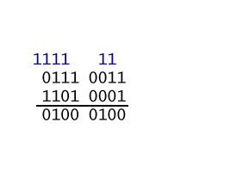
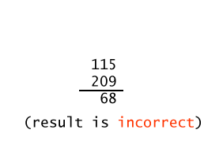
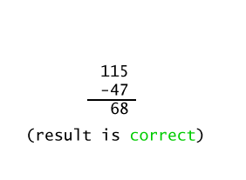
Overflow Detection in 2’s Complement
Algorithm applied to bit patterns | Interpretation of the patterns as unsigned binary (shown in base 10) | Interpretation of the patterns as 2's complement (shown in base 10)
NO OVERFLOW: If the carry INTO the high order column equals the carry OUT OF the high order column.

Slide 18
Carry In == Carry Out
Overflow Detection with Two's Complement Operands
No Overflow | No Overflow | Overflow | Overflow
11111 111 0011 1111 ( 63₁₀) 1101 0101 (-43₁₀) 0001 0100 ( 20₁₀) | 00000 011 1100 0001 ( -63₁₀) 0010 1011 ( 43₁₀) 1110 1100 ( -20₁₀) | 01111 100 0011 1111 ( 63₁₀) 0110 0100 ( 100₁₀) 1010 0011 ( -93₁₀) | 10000 000 1100 0001 ( -63₁₀) 1001 1100 (-100₁₀) 0101 1101 ( 93₁₀)

Slide 19
ASCII Character
Hex Char | Hex Char | Hex Char | Hex Char
00 nul | 20 sp | 40 @ | 60 `
01 soh | 21 ! | 41 A | 61 a
02 stx | 22 " | 42 B | 62 b
. . . | . . . | . . . | . . .
0A lf | 2A * | 4A J | 6A j
. . . | . . . | . . . | . . .
1E rs | 3E > | 5E ^ | 7E ~
1F us | 3F ? | 5F _ | 7F del

